Slide 2
Walk in the footsteps of St Ignatius and with our sisters and brother of Myanmar.
While the youth and people of Myanmar are fighting for their lives and futures, show them they are not alone and walk in solidarity for them.
On 31 July, St Ignatius Day walk for the people of Myanmar.

Slide 3
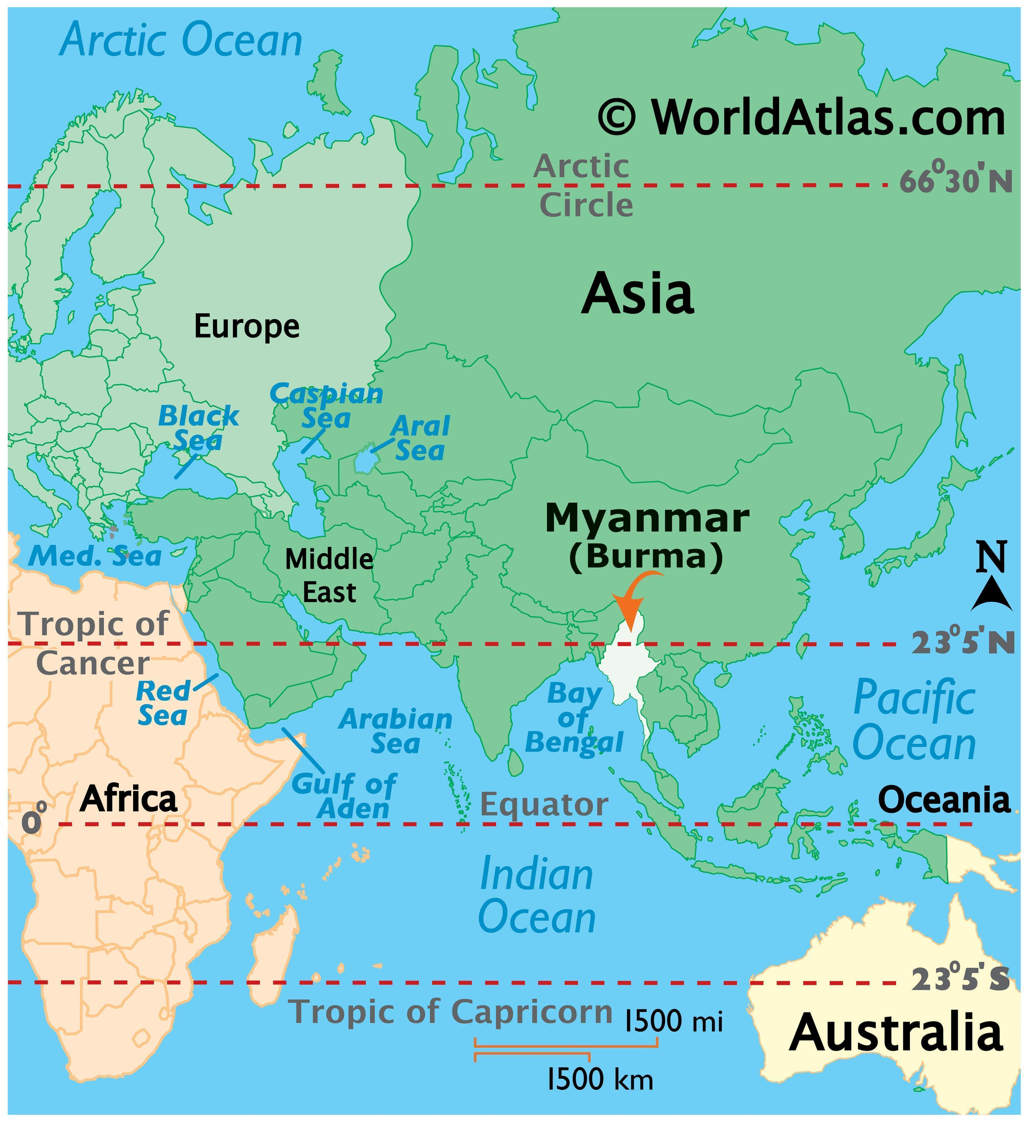
THE PEOPLE OF MYANMAR
NEED OUR HELP
Since the military coup in February 2021:
2.8 million displaced people.
18.6 million people living in dire need.
13 million young people facing compulsory conscription.
One third of school aged children not enrolled in school.

Slide 4
Blaze your own trail
Sign up to OFR
WALK
Share your page
Take action to help change lives!
Set up your personal OFR page and share with your family and friends.
On 31 July, St Ignatius Day, walk for the people of Myanmar.

