Slide 1
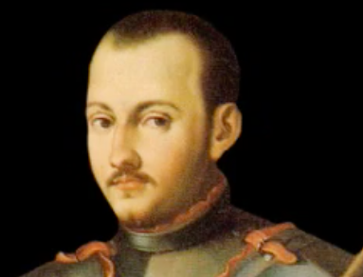
Saint Ignatius
A kind man who showed us how to love

Slide 2
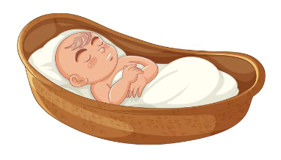
Ignatius was born in a small town called Loyola which is in Spain.
His real name was
INIGO LOPEZ

Slide 3
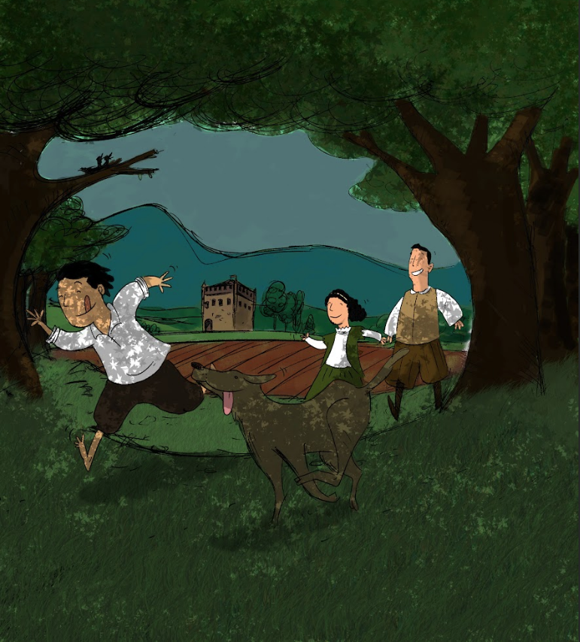
Ignatius loved to play and enjoyed adventures

Slide 4
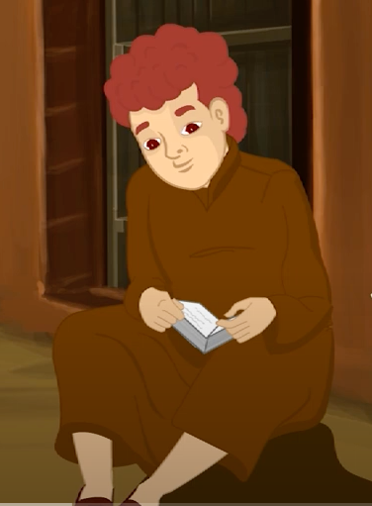
As a boy, school was important to Ignatius.
He tried very hard to learn.

Slide 5
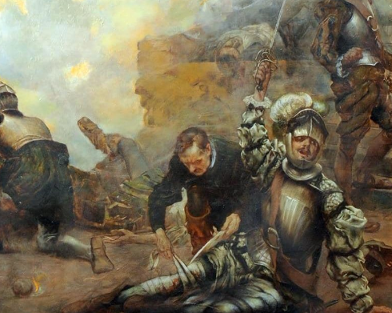
He was injured and hurt his leg very badly

Slide 6
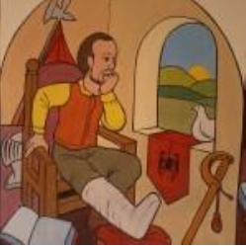
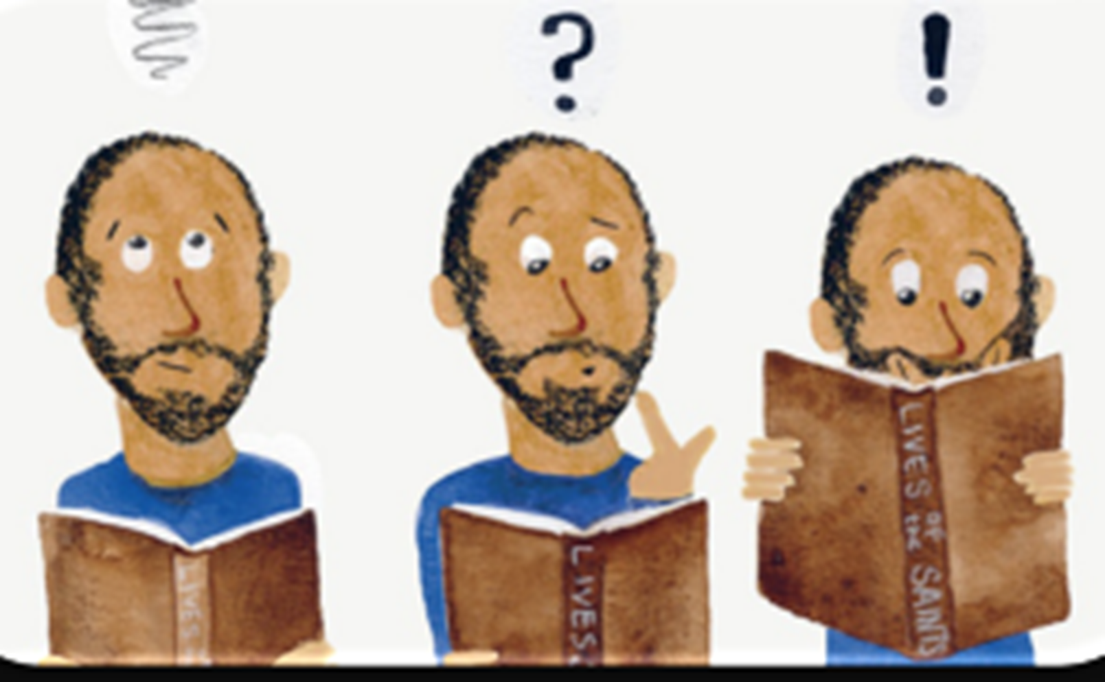
While he was healing in bed, he read some books about the life of Jesus, and some very kind people called saints.

Slide 7
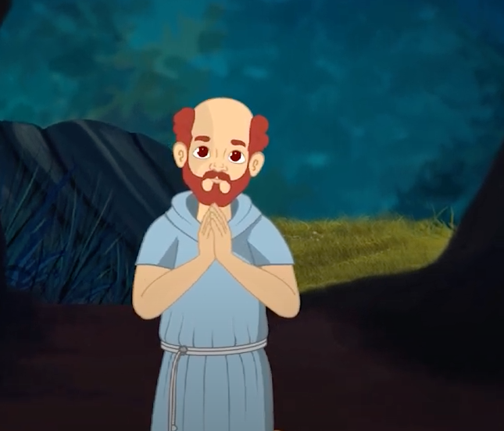
After he recovered, Ignatius went on a big walk and spent time by himself. He prayed a lot and thought of some ideas about he could become closer to God.

Slide 8
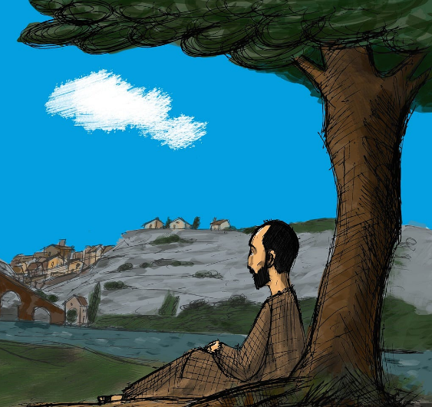
He saw beauty in nature and began to find God in the simple things of life.

Slide 9
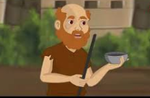
Ignatius decided he wanted to change from his old life as a soldier.
He wanted to concentrate on being like Jesus.
By being kind to others, it helped Ignatius to feel happy and closer to God.

Slide 10

He discovered there were a lot of people who needed help. He decided to spread love and show them kindness and teach them about God.

Slide 11
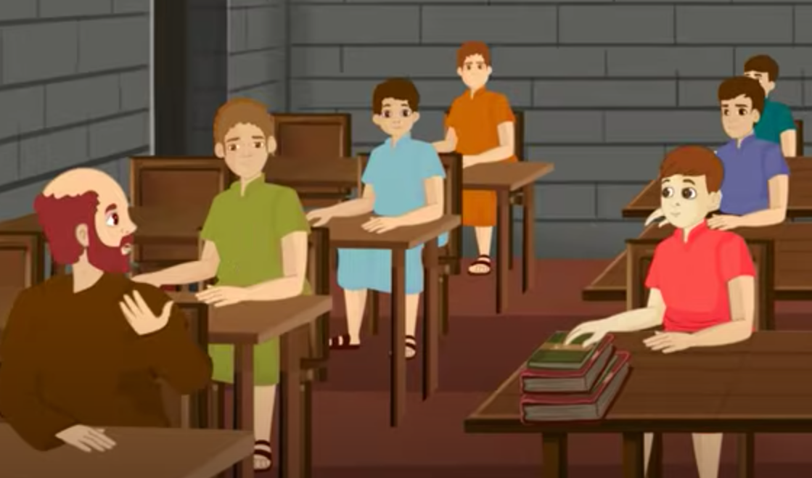
To become a priest & say mass, Ignatius needed to learn a different language called Latin.
So, when he was a grown-up, he went back to school with the young children.
It must have been hard for Ignatius.

Slide 12
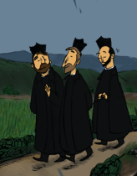
Later, he went to University where he met some friends called Francis Xavier and Peter Faver. They helped Ignatius be kind to others

Slide 13
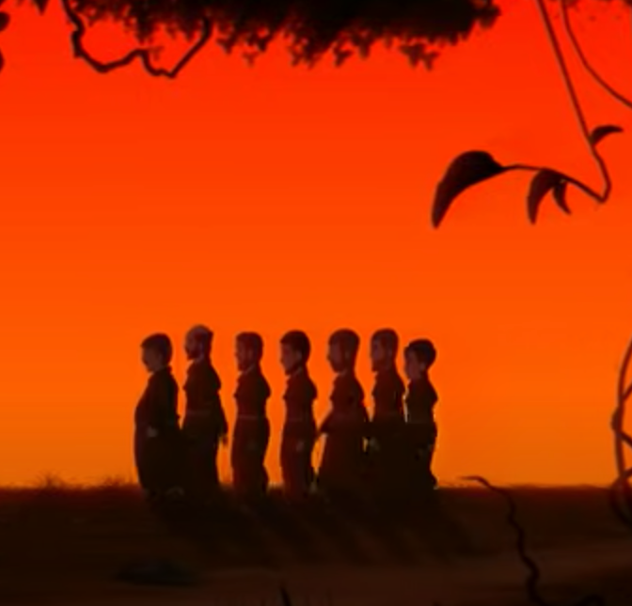
Lots more friends joined them.
They were called the Society of Jesus
Or
JESUITS

Slide 14

They travelled to lots of places far away, like India & Germany, to teach others how to be kind and live like God.

Slide 15
Jesuit Mission Australia are a group of people who try to love like Saint Ignatius.
They choose to be kind to people who need help
Add team photo

Slide 16
Here are some of the people that Jesuit Mission has helped.
What can you see?
I wonder how Jesuit Mission helped these children?
Add photos

Slide 17
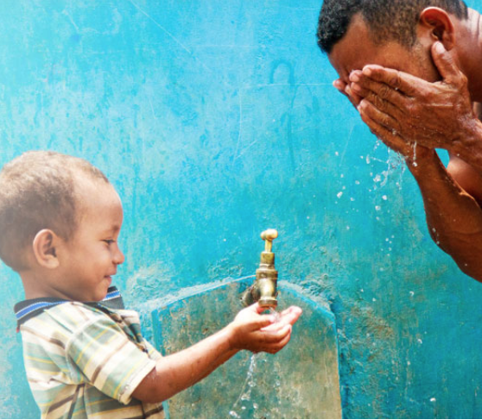
What can you see?
What do you think?
What do you wonder?
These people didn’t have water near their home & had to walk a very long way to get it.
Jesuit Mission helped to get them water from a tap near their home.

Slide 18
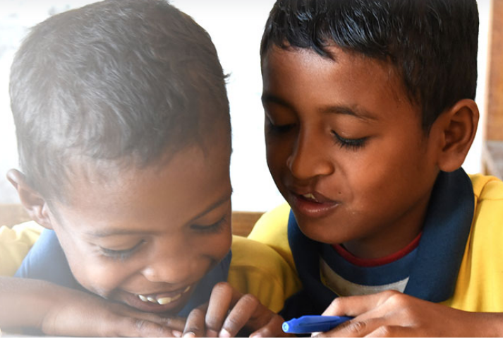
What can you see?
What are the boys feeling?
Why?
Jesuit Mission helped these boys and lots of children just like them to go to school and learn

Slide 19
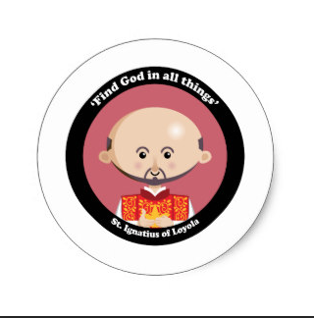
Saint Ignatius asked us to find God in all things.
What does this mean?
Where can you find God?

Slide 20
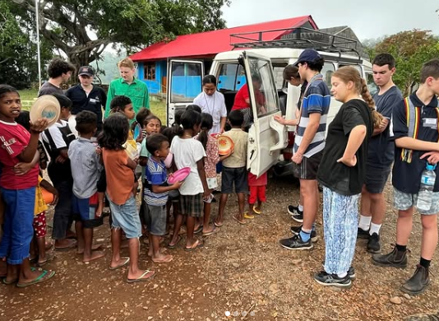
What can you see?
Can you find kindness in this picture?
Can you find God in this picture?
When you have found kindness you have found God

Slide 21

Saint Ignatius lived a long time ago, but he wrote down lots of his ideas to share.
We can try to be like Saint Ignatius & choose kindness every day

Slide 22
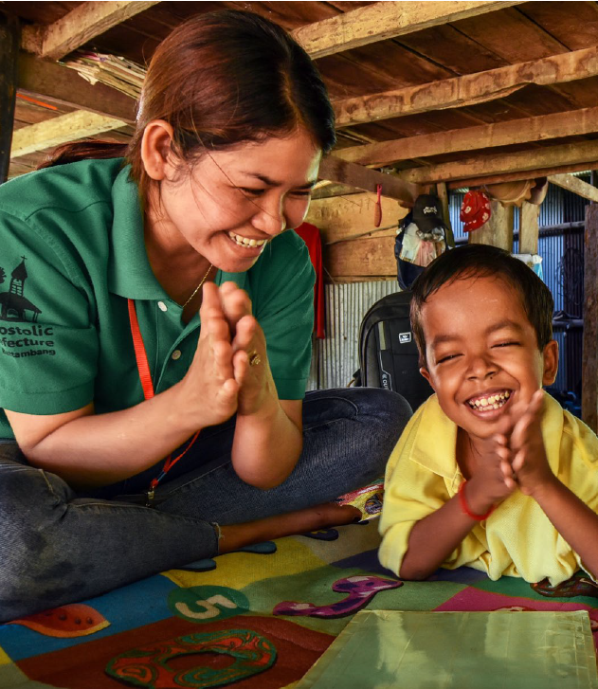

With gratitude

